Slide 1






BCs3143
Software Project Management

Slide 2


3
PROPOSED SYSTEMS / APPS
E-BOOK READING SYSTEM

Slide 3





4
To develop a mobile application called an E-Book Reading System for readers to read online books using the ePub or PDF file type
PROJECT
MISSION

Slide 4

5
Period / Time
6 Months
PROJECT TIMELINE, COST & STAKEHOLDER
Cost
RM 60, 000
Stakeholders
Project Manager
Development Team
Online readers

Slide 5


8
PROJECT MANAGEMENT BEST PRACTICE
Project Management Body of Knowledge (PMBOK)
Projects IN Controlled Environments (PRINCE2)
Developed by Project Management Institute (PMI) in USA.
Structured project management method and practitioner certification program.
Adopted in worldwide including UK, western European countries and Australia.
Initially developed as UK government standard. In 2013 transferred to Axelos Ltd.

Slide 6
8
PROJECT MANAGEMENT METHODOLOGY (PMBOK)
PHASE | ACTIVITIES | DELIVERABLES
INITIATION | Develop Project charter Identify stakeholder | Project charter document
PLANNING | Develop project management plan Define scope Create WBS & Develop schedule Estimate cost & Determine budget Plan resource Communication management Risk Management Procurement Stakeholder Management | Project implementation plan ~ Timeline ~ Cost ~ Resource ~ Risk ~ Procurement
EXECUTION | Execute & manage the plan Acquire project team
CONTROL & MONITORING | Perform change control | Change control Progress Report
CLOSING | Close project – i.e Procurement | Project closure Lesson learnt

Slide 7

8
Draft a Project Charter outlining objectives, scope, and initial constraints.
Identify and analyze stakeholders involved in the E-book Reading System project.
Conduct a feasibility study to assess technical, financial, and operational viability.
Perform an initial risk assessment to identify potential risks and uncertainties.
Hold a project kickoff meeting with key stakeholders to align on objectives, roles, and responsibilities.
PROJECT MANAGEMENT PHASE
INITIATION

Slide 8
PROJECT CHARTER
1 | Project Name | E-Book Reading System
2 | Description | A system made for readers to read book with the ePub or PDF file type and manage their library.
3 | Objectives | To develop a mobile application called an E-Book Reading System for readers to read online books using the ePub or PDF file type.
4 | Date / Time | 1st of April 2024 until 1st of October 2024 / 6 Months
5 | Project Manager | Jamaludin Sallim
6 | Deliverables | A mobile application to read ePub / PDF file type. A tutorial for new users on how to use the system. A list of personal library for each user. Users can annotate, bookmark, and comment on their own book how they like.

Slide 9
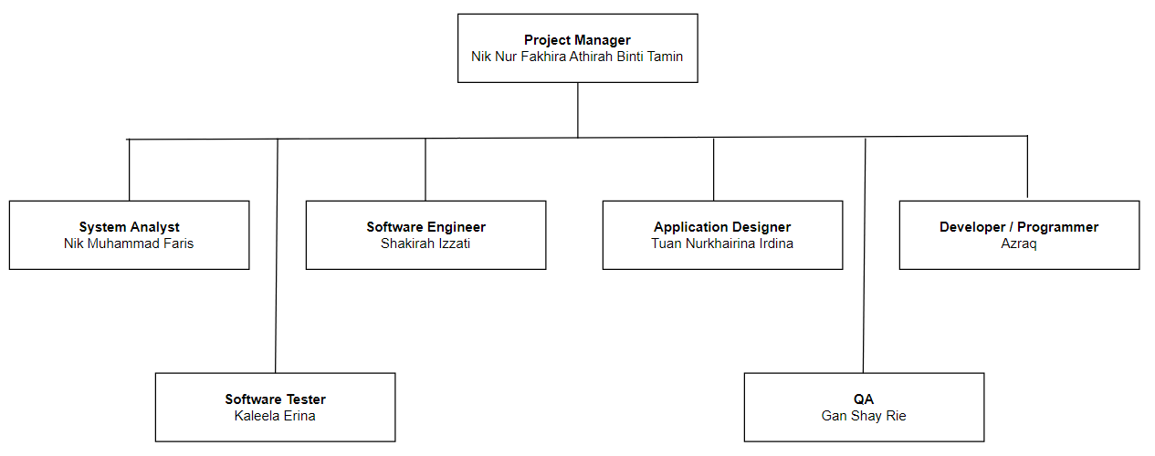
PROJECT CHARTER
7 | Organization Structure
8 | Risk / Limitation | -
9 | Cost | RM60, 000

Slide 10
STAKEHOLDER
People Involved in the system:
The project manager
The development team
The analysts and software engineer
The alpha / beta tester
People affected by the system:
Users who download the application

Slide 11
9
Develop a detailed project plan outlining tasks, timelines, resources, and dependencies.
Define project milestones and deliverables to track progress and ensure accountability.
Conduct a requirements gathering session to gather and document specific functional and non-functional requirements for the E-book Reading System.
Create a communication plan to ensure effective communication among project team members, stakeholders, and other relevant parties.
Establish a risk management plan to identify, assess, and mitigate potential risks throughout the project lifecycle,
PROJECT MANAGEMENT PHASE
2. PLANNING

Slide 12
10
PROJECT MANAGEMENT PHASE
Develop the E-book Reading System according to the specifications outlined in the project plan.
Procure necessary hardware, software, and resources for system development and deployment.
Monitor project progress against milestones and deliverables, implementing controls as needed.
Conduct thorough testing and quality assurance activities to ensure system functionality and performance.
Maintain regular communication with stakeholders to provide updates and gather feedback throughout the execution phase.
3. EXECUTION

Slide 13
11
Implement performance measurement and reporting mechanisms to track project progress.
Manage risks by continuously identifying, assessing, and developing mitigation strategies.
Establish a change control process to evaluate and approve any alterations to project scope or requirements.
Optimize resource allocation to ensure efficient use of personnel, equipment, and budget.
Conduct ongoing quality assurance activies to maintain project quality and implement improvements based on feedback.
PROJECT MANAGEMENT PHASE
4. CONTROL & MONITORING

Slide 14
12
Conduct a final review of project deliverables to ensure they meet quality standards and fulfill requirements.
Obtain formal acceptance and sign-off from stakeholders to acknowledge completion of project objectives.
Document lessons learned from the project, including successes, challenges, and areas of improvement.
Archive project documentation and deliverables for future reference and audit purposes.
Hold a project closure meeting to celebrate achievements, thank team members, and officially close out the project.
PROJECT MANAGEMENT PHASE
5. CLOSING

